Slide 1


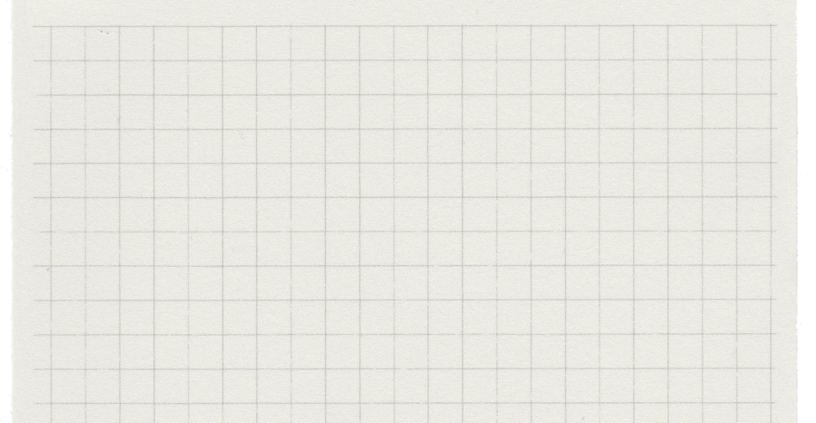






By-
-Vishal Bajpai
-Shashank Devashetty

Slide 2
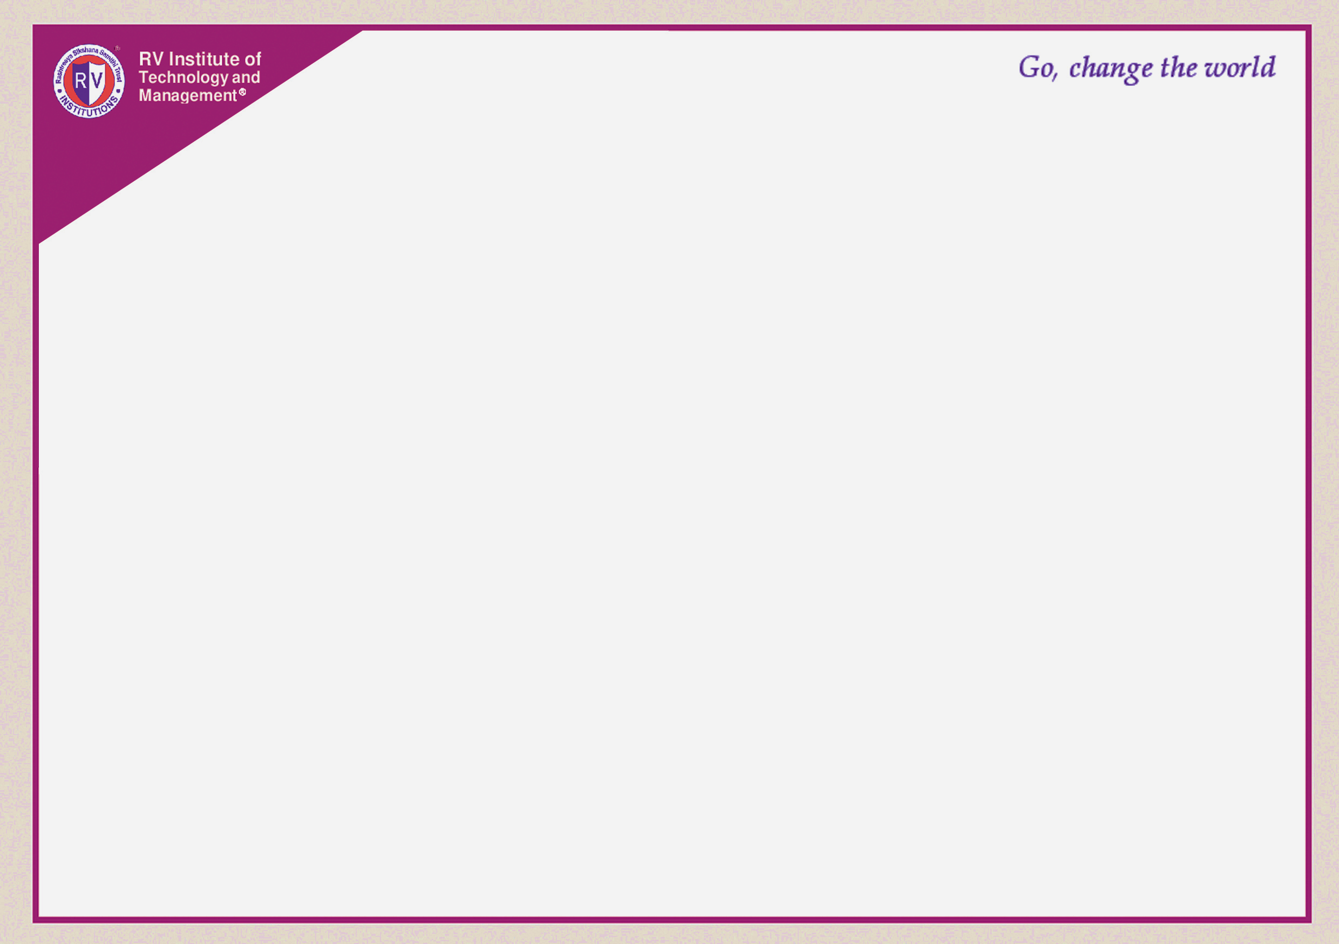
Introduction
Project on Nutrition Management –
Won Peace
-A platform that provides custom-fit nutrition plans to promote health and well-being, symbolizing a victory over dietary struggles.
By:
Vishal Bajpai (1RF20IS063)
Shashank Devashetty (1RF20IS050)

Slide 3
Abstract
In the current fast-paced society, it is hard for the working class to eat healthy and nutritious food, so for people to know what they should eat we created Won Peace. Won Peace is a web application that takes the user’s vital statistics and calculates the right amount of nutrition required for them and suggests a personalized and detailed diet plan for each user.

Slide 4
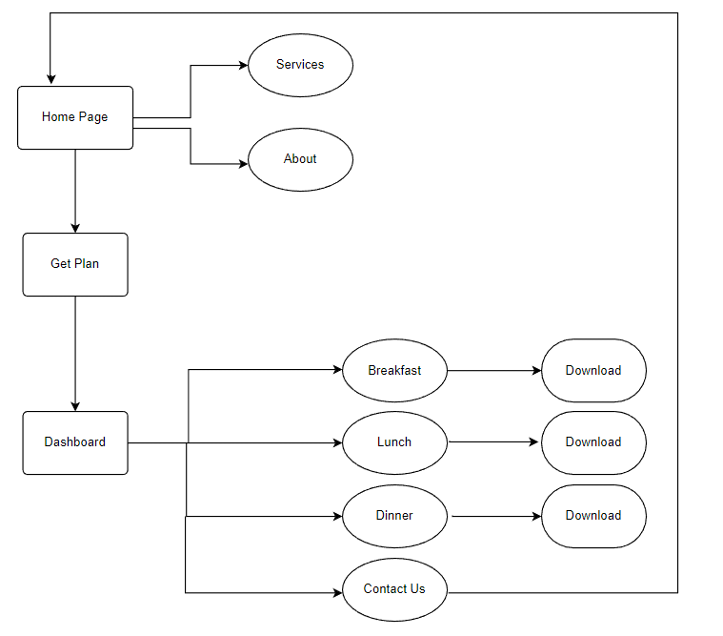
System design

Slide 5
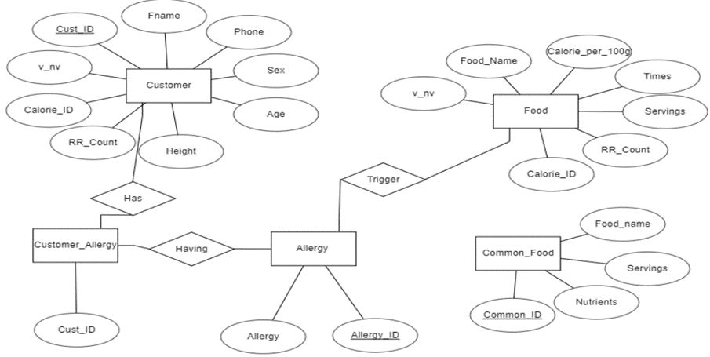
ER Diagram

Slide 6
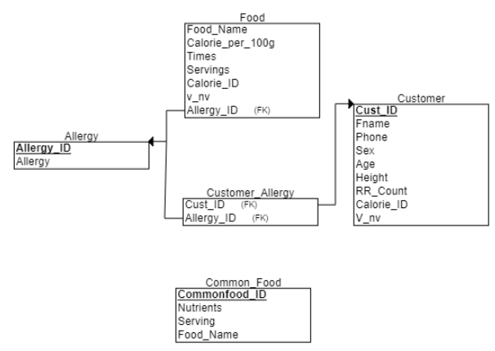
Schema Diagram

Slide 7
Implementation
Front End Tools:
HTML 5
CSS
Tailwind CSS
Web Servers:
Xampp
Back End Tools:
PHP
MySQL

Slide 8
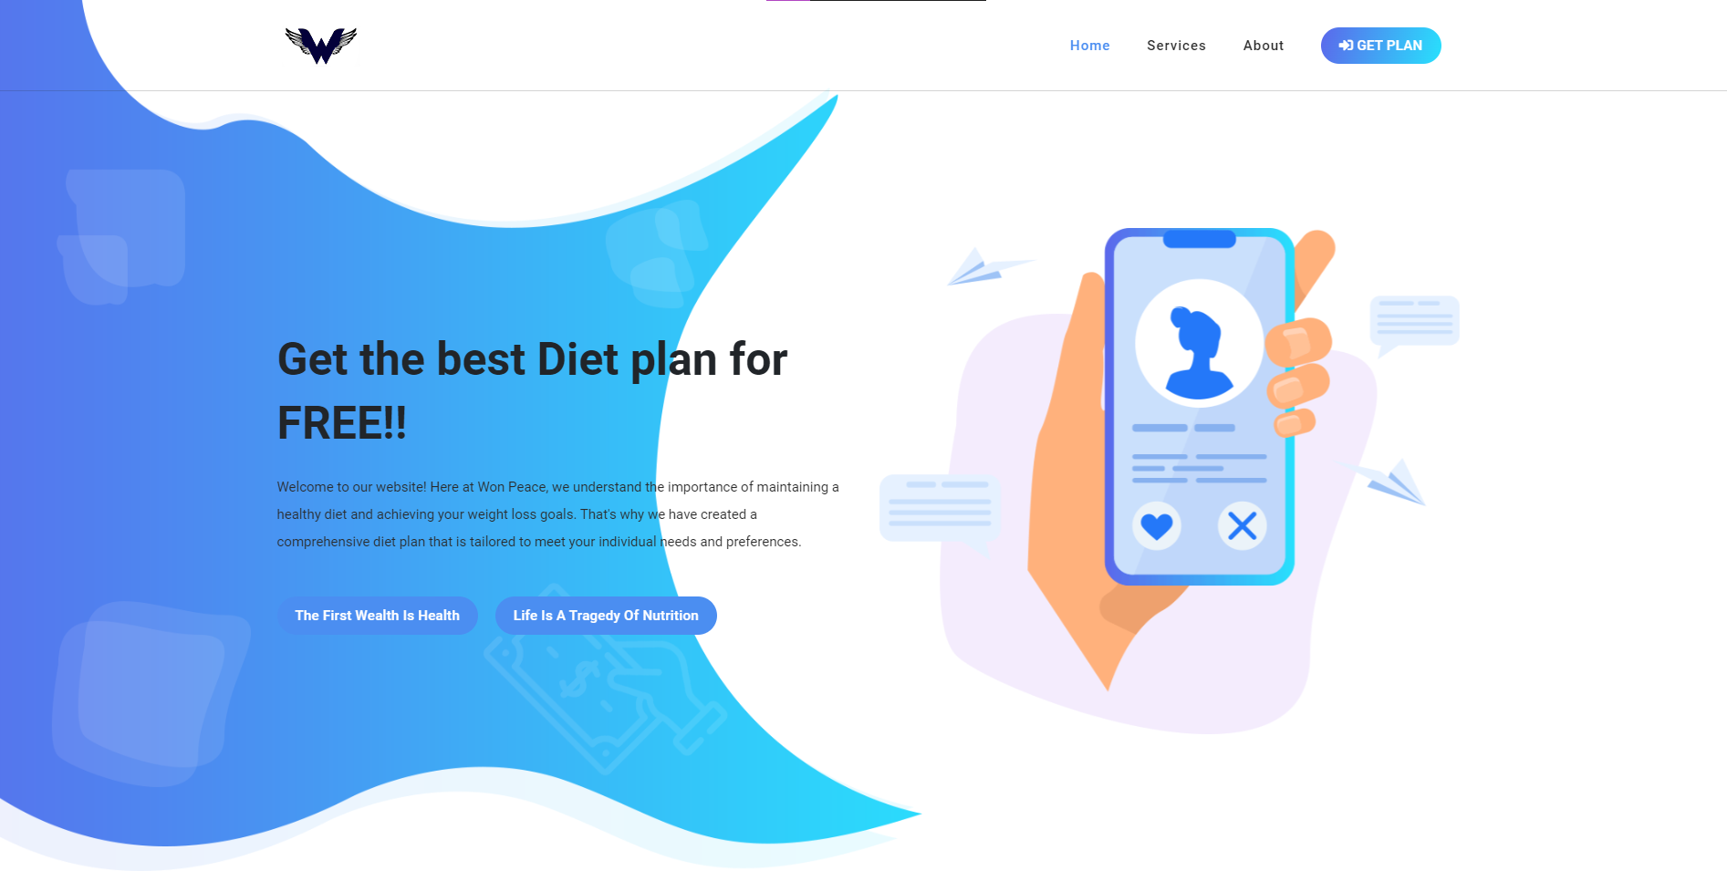
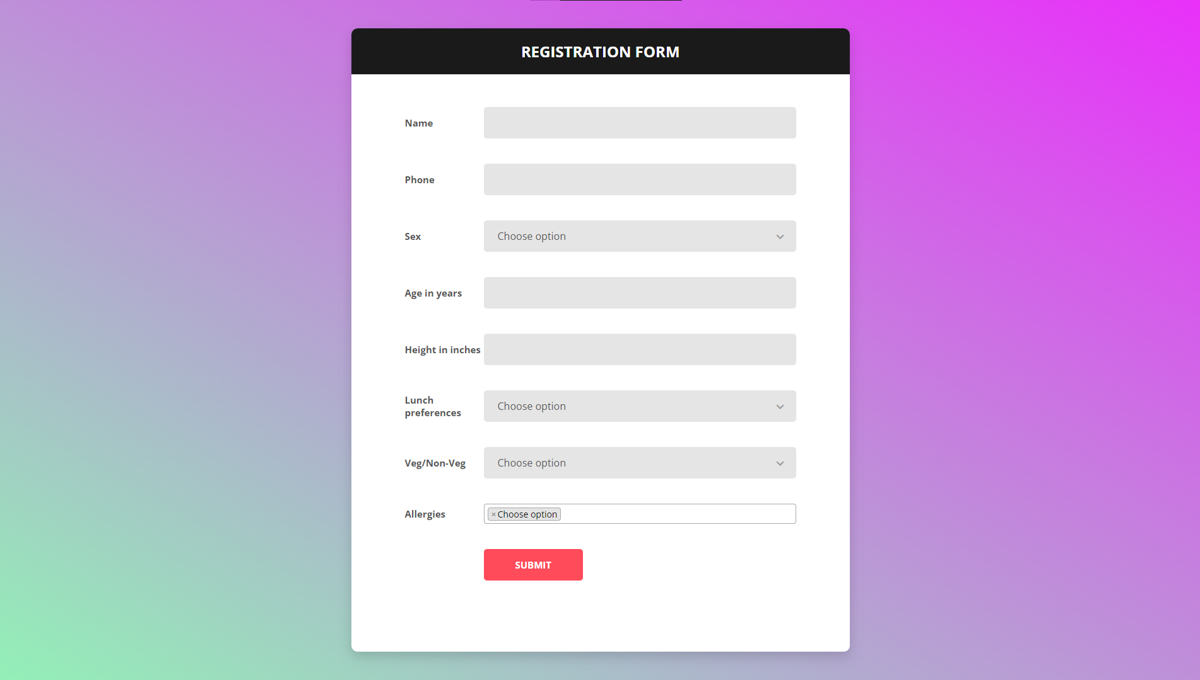
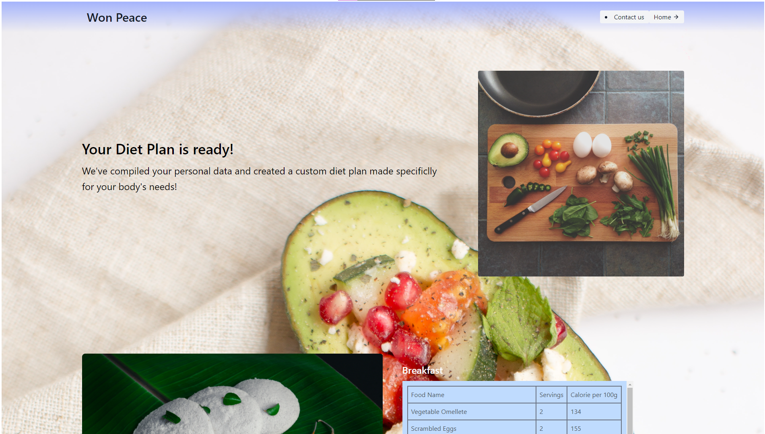
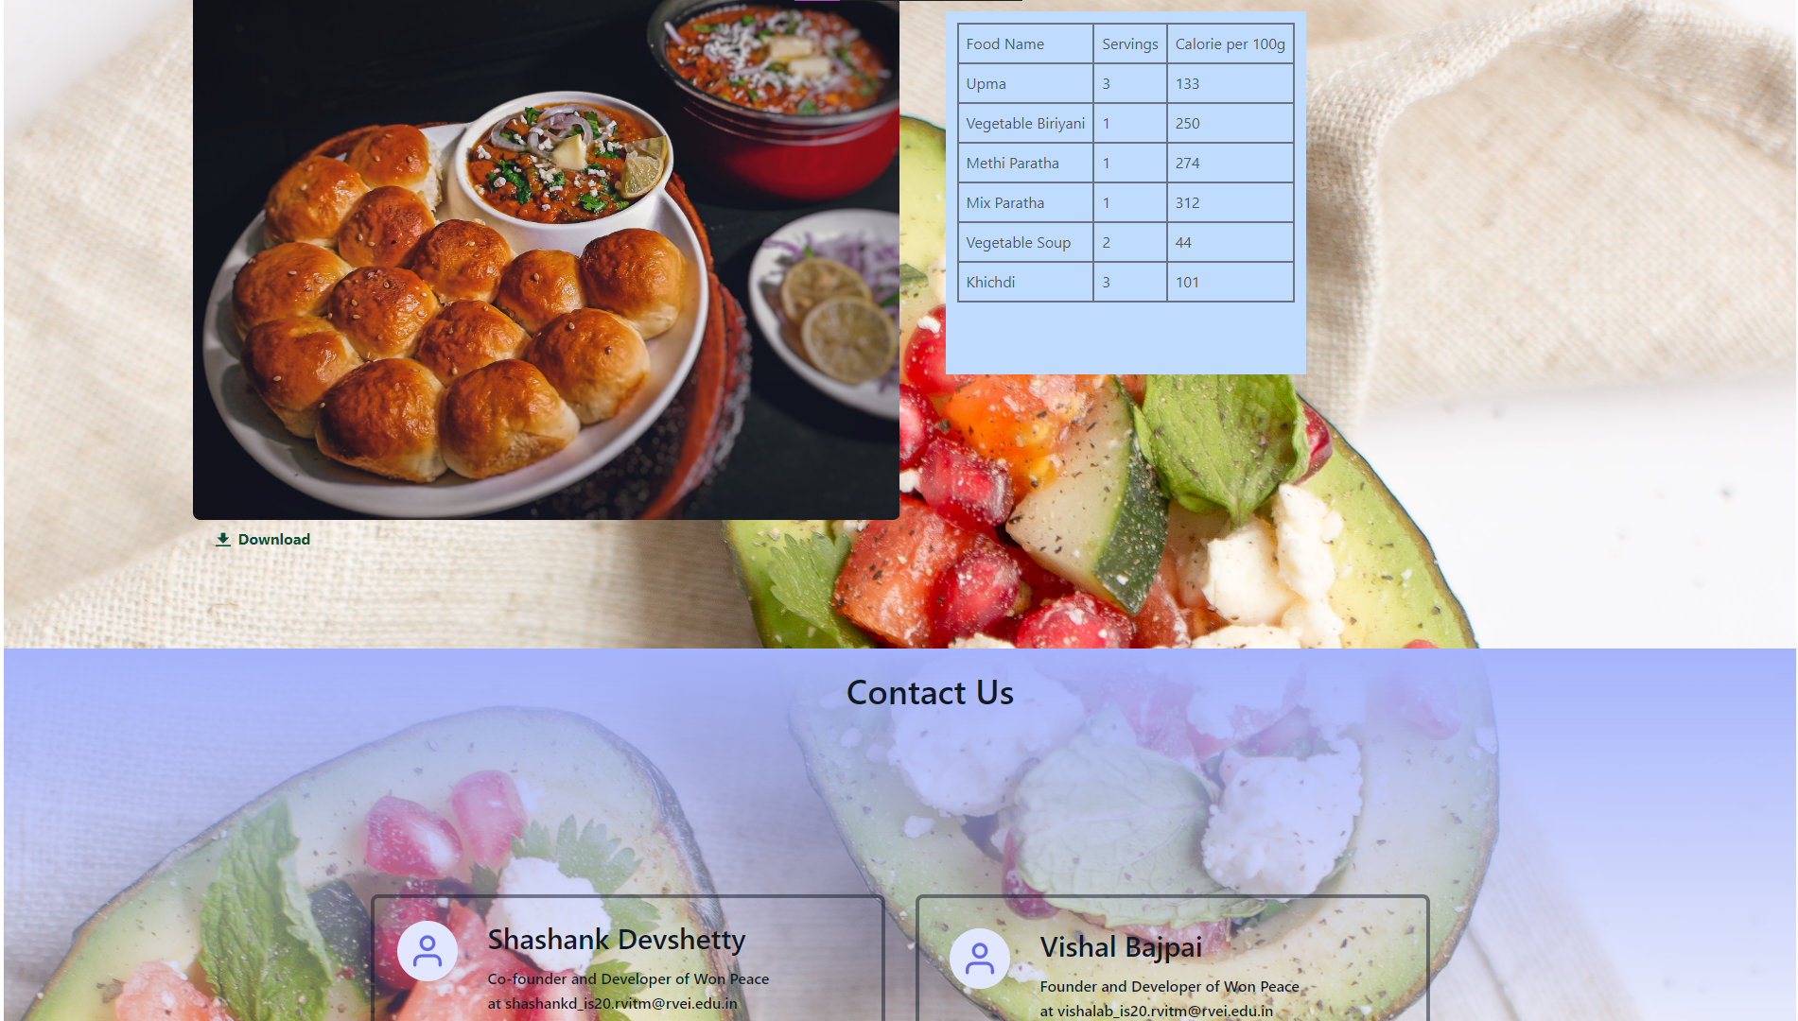
MODULES
About page
Registration Page
Dash Board

Slide 9
Conclusion
In conclusion, the website provides a comprehensive solution for generating personalized diet plans. As for future enhancements, one major potential enhancement would be to convert the website into a mobile application. This would provide users with an even more convenient way to access and manage their personalized diet plan. A mobile app would allow users to access their diet plan on-the-go, and make it easier to track their progress and make adjustments as needed. Additionally, this would be a great idea for a 8th semester project, as it will give us the opportunity to learn and apply new technologies and methodologies.

